Slide 1
PROJECT : CASPER
Conduit Assessment
Systems Performance
Excellent Retailing
Kick Off Presentation
April 21, 2003

Slide 2
Contents
KGC Strategic Direction and Business Goals
Supply Chain Assessment Project
  Objectives
  Project Team
  Approach
Our Required Commitment

Slide 3
KGC Strategic Direction
KGC strategic vision is to be the #1 Health Care Provider in the markets it serves
  This is to be enabled by three key initiatives:
    Continued growth through acquisition
    Improvements in its information technology capabilities
    Focus on superior product segmentation and merchandising
These will all place demands on business integration (specifically process and technology integration) and better cash flow
  Other drug retailers including Shoppers, Boots, CVS and Eckerd’s (amongst others) have all been involved in recent programs to better align their processes and technologies to their overall strategic objectives. These include supply chain projects, customer intimacy initiatives and systems implementations.
  Mass merchant retailers are expanding their pharmacy operations threatening to impact our top line performance and market share. Loblaws, Sobeys and of course, Wal*Mart, are all targeting increased pharmacy revenues.
  This is even more relevant given recent studies showing pharmacy “back store” profitability, where KGC has traditionally focused, is decreasing while “front store” performance is increasing.

Slide 4













KGC needs to ensure its supply chain strategy is aligned with its business strategy
SELF EXPRESSION
Opportunist
Lifestyle
Mass Value
Solver
?
?
BASIC NEEDS
PRODUCTS
SOLUTIONS

Slide 5
Our Operational Goals
Growth
  Grow the business by 10-15% over the next three years and add between 30 and 50 stores annually
Process Performance
  Increase front store sales
  Reduce overall inventory levels
  Increase service levels and therefore revenue by ensuring the right product is on the right shelf at the right time at the right price
  Decrease procured product costs by increasing strategic sourcing
  Increase overall efficiency by leveraging a shared services approach across back office functions of the enterprise/banners
  Establish enterprise wide standards for processes
Technology Alignment
  Improve enterprise and banner-specific systems to enhance overall data integration and information visibility
  Establish enterprise wide standards for technology

Slide 6
Contents
KGC Strategic Direction and Business Goals
Supply Chain Assessment Project
  Objectives
  Project Team
  Approach
Our Required Commitment

Slide 7
Project Objectives and Deliverables
The primary objective of this project is to define exactly how KGC has to improve its supply chain performance to enable greater product availability at the store shelf and reduce system-wide inventory levels.
A secondary set of objectives focuses on gaining greater control of our supply chain. As our business grows, becomes more complex and demands more flexibility, KGC needs to re-asses how best to utilize our Logistics' services.
The deliverables from our project will include:
  an assessment of strategic opportunities for KGC in supplier relationships
  an assessment of potential changes to relationship with McKesson for selected categories
  an operational assessment of KGC vs. best practices to identify where KGC can focus on short term and long term savings in supply chain operations
  an operational assessment of KGC vs. best practices to identify where KGC can focus on short term and long term savings in store operations and merchandizing
  identification of high-potential Supply Chain opportunities by business or division
  estimated savings for top opportunities
  positioning of opportunities based on benefits and ease of implementation
  identification of “quick wins” to start realizing the identified benefits

Slide 8
Project Scope
The following KGC banners and divisions are included in the scope of the project:
  Drug Trading Co Ltd
  PharmaPlus DrugMarts Ltd
  Pharmx Rexall Drugstores Ltd
  Medicine Shoppe Canada Inc
  Herbie’s Discount Drugs
  MediTrust Healthcare
  ProPharm
  DC Labs
  Snyder’s Drugstores
  The Drug Emporium
The assessment will focus on all supply chain processes (excluding manufacturing) including:
  Forecasting and assortment planning
  Strategic sourcing
  Procurement and buying
  Inventory planning
  In bound Order processing
  Payment
  Store replenishment planning
  Store replenishment execution
  Warehousing and transportation
  Invoicing and collections
Manufacturing is not in scope;
US based chains and not in scope

Slide 9
Retail Cycle
Analyze
Measure, Monitor & Manage
Plan
Execute
Plan
Buy
Order
Follow-Up
Move
Store
Logistics
Sell
Track
Results
Supporting Services

Slide 10
Project Team
Project Sponsors
L. Latowsky
M. Martin
Provide Vision
Manage McKesson relationship
Make strategic decisions
Resolve project issues
Attend update meetings
Day-to-Day direction
Coordinate activities
Project administration
Collect/ Analyze data
Summarize results
Develop reports/ presentations
Advise on “SME” requirements
Develop Communications Plan
Perform change readiness assessment
Key Stakeholders
A. Parkes
B. Elliott
T. Buckley
Steering Committee
Chair: M. Martin
IT: G. Schwartz
Rx: G. Sone
HR: P. Davidson
Ops: B. Moody
Merchandising: T. Buckley
Advisor: L. Casalino
Subject Matter Experts
Finance: Various
IT: Various
Operations: All Banners
POS: Various
Merch.: Various
PPH: Various
McKesson: Various
IBM: Various
Project Management Office
PM: R. Martins
Coordinator: C. McDermott
IBM: S. Verma
Core Team
Corporate: C. Rendek / W. Liu
Operations: All Banners
McKesson: TBD
IBM: A. Pinington
IBM: A. Cina
Change Management
Communications: M. Dixon
IBM: N. McTavish

Slide 11
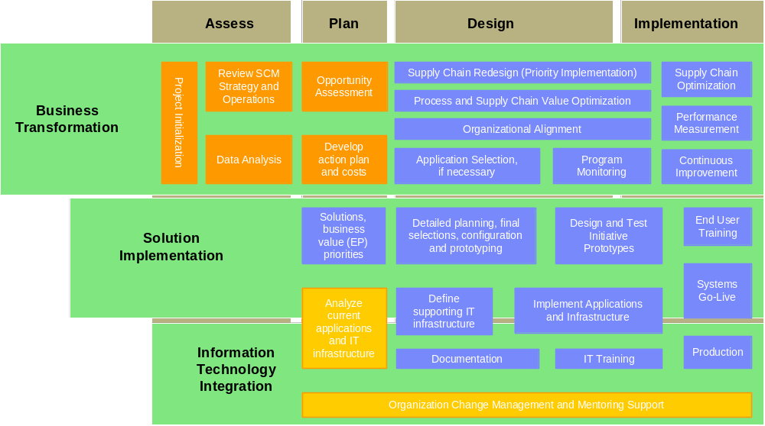
The Supply Chain Assessment project will be conducted using IBM’s supply chain methodology
April ‘03
July ‘03
2004
2005

Slide 12
Project Initialization
Objectives
Project Initialization
Review SCM Strategy and Operations
Opportunity Assessment
Provide understanding of project goals & scope
Confirm schedule, key meetings & resources
Confirm team members, roles and responsibilities
Identify sources of data and information and initiate data collection
Data Analysis
Develop action plan and costs
Approach
Deliverables
Meet with KGC sponsors/project manager
  Confirm project team members
  Confirm roles and responsibilities
  Confirm scope, approach and objectives of engagement
  Schedule key interviews, warehouse walkthrough and meetings with participants
  Finalize project schedule
  Review expectations of deliverables
Identify data collection requirements
  Financials
  Product and customer details
  Procurement and Supply Chain Processes
  Applications details
  Technology details
  Reporting mechanisms, existing and planned KPIs and other metrics
Kick-off meeting with extended team
Project team roles & responsibilities
Confirmed scope and objective statements
Outline of engagement deliverables
Project plan
List of information (with format) which KGC will provide to IBM
Kick-off package

Slide 13
Understand Strategy, Process, Organization, Application and Technology Environment
Objectives
Project Initialization
Review SCM Strategy and Operations
Opportunity Assessment
Gain an understanding of KGC’s vision, operating strategy, goals, and business drivers (with focus on the supply chain)
Understand internal and external customer perception regarding current supply chain performance
Understand business issues within the supply chain
Data Analysis
Develop action plan and costs
Approach
Deliverables
Review relevant and related documentation
Prepare for and conduct interviews with key stakeholders, including CEO, Operations, Finance, Procurement, Store Operations, Accounts Payable, Pharmacy Operations, IT, independent stores and corporate stores
Review future IT strategy, restrictions and directions at a high level (through interviews)
Review the approach, issues and opportunities related to supply chain functions and processes (through interviews)
Review competitors, their logistics environment and service levels and market position
Gather product and customer data for further analysis in step three
Identify customer service objectives
Initial findings on:
  Critical business plan assumptions such as new markets, services, categories, etc.
  Key business issues and objectives
  List of strategic initiatives under way
  List of high level business drivers
  List of key performance metrics
  Current technology application model
  Organizational model
  Change management issues

Slide 14
Gather Data to Identify and Assess Costs, Metrics, Opportunities and Quick Wins
Objectives
Project Initialization
Review SCM Strategy and Operations
Opportunity Assessment
Understand “As-Is” environment
Understand opportunities for improvement in Supplier Management, Strategic Sourcing, Procurement, Store Replenishment (by comparing with best practices) and store operations
Identify alternative approaches by product category
Data Analysis
Develop action plan and costs
Approach
Deliverables
Document “As-Is” supply chain processes through interviews and workshops
Gather and analyze cost, service and inventory data including:
  Turnover rates
  Deployment patterns
  Seasonal builds
  Stocking and replenishment policies
Identify key performance indicators and key metrics
Identify ‘quick wins’ and appoint client teams for rapid implementation
Assess product and customer data for opportunities to categorize by different distribution models
As-is supply chain process maps (at a high-level), organization, applications and technology landscape for each KGC business across in-scope process areas
Assessment of KGC vs. best practices
Opportunities and Quick Win and client teams to implement the Quick Wins
Observations and list of preferred options for input to Executive Visioning workshop
Current metrics and service levels

Slide 15
Assess Preferred Opportunities and Develop Metrics
Objectives
Project Initialization
Review SCM Strategy and Operations
Opportunity Assessment
Assess level of supply chain awareness and the need for KGC to educate its executive and key staff
Solutions portfolio containing the top solutions for supply chain for each KGC business channel
Estimated potential business case for preferred opportunities
Data Analysis
Develop action plan and costs
Approach
Deliverables
Conduct executive visioning opportunity workshop to:
  Review assessment results
  Brainstorm high-level future processes capabilities
  Assess/rank options according to ease/strategic benefit
  Identify top opportunities
Document results of work session
Prepare descriptions of opportunities and supporting information to help estimate benefits
Document potential alternative supply chain options as required for top opportunities
Design “To-Be” process, organization and technology blueprints through workshops, meetings, etc.
List of key performance indicators, metrics and targets
Estimated savings for top opportunities
Prioritization of opportunities based on benefits and ease of implementation

Slide 16
Develop Recommendations, Business Case and Next Steps
Objectives
Project Initialization
Review SCM Strategy and Operations
Opportunity Assessment
Action plans for selected opportunities (quick wins already have been launched)
Estimated required resources and high level costs
Document dependencies
A change management plan to support the successful implementation of the change program
Data Analysis
Develop action plan and costs
Approach
Deliverables
Document guidelines, principles and assumptions
Conduct a workshop with key stakeholders to create action plan for top priority initiatives, including:
  High level action plan with tasks
  High level time frame
  Resources / responsibilities
  High level costs (range only)
Using our methodologies and tools, will assist KGC to calculate its business case for top opportunities
Develop high level change management plan
Develop executive presentation
Opportunity summary
Business case for preferred opportunities
Action plan for moving forward
Change management plan
Resource estimates
Executive presentation

Slide 17
An End-to-End Assessment
The final deliverable of the Supply Chain Assessment and Planning exercise is an executive presentation with clearly defined targets for savings
  Assessment of strategic opportunities for KGC in supplier relationships
  Assessment of potential changes to relationship with McKesson for selected categories
  Operational assessment of KGC vs. best practices to identify where KGC can focus on short term and long term savings in supply chain operations
  Operational assessment of KGC vs. best practices to identify where KGC can focus on short term and long term savings in store operations and merchandizing
  Portfolio of high-potential Supply Chain opportunities by business or division
  Estimated savings for top opportunities
  Positioning of opportunities based on benefits and ease of implementation
Quick Wins identified with an action plan for moving forward on the major improvement opportunities, including resource estimates and a high level change management plan

Slide 18
Contents
KGC’s Strategic Direction and Business Goals
Supply Chain Assessment Project
  Objectives
  Project Team
  Approach
Our Required Commitment

Slide 19


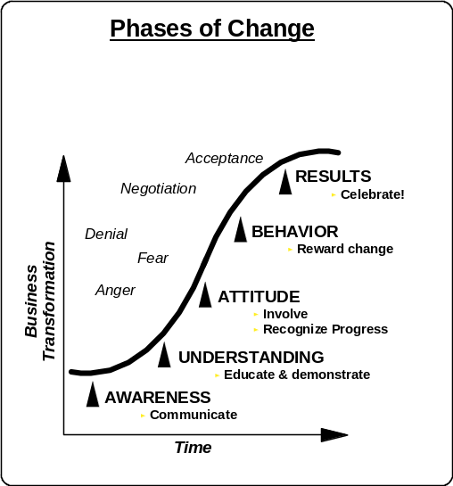
KGC’s ability to make necessary changes will be critical to fully capture the opportunities that will be identified in our project
Business Context
Current
State
Organization
& People
Change
Management
Process
Desired
State
Information
Technology
Minimize the transition period up the change curve
Minimize the pain and disruption associated with the transition
Minimize resistance to change
Maximize commitment and “buy-in”
Maximize the results of the transition
Change Impact
Performance
$
Business
$
Time

Slide 20
Your Role
The Communication Escalator
Advocacy
Fully committed to taking the change further and trying to involve others. You are an advocate.
Ownership
Being involved in deciding how the change will be implemented successfully.
Degree of Change
Buy-in
Understanding implications of change and supporting it.
Awareness
Not supporting change,
but not getting in the way.
Degree of Involvement

Slide 21
KGC’s Organizational Commitment to the Project
KGC management and staff need to support this project in the following ways:
  Confirm overall business strategy
    Supply chain strategy needs to be fully aligned and linked to the business strategy
  Make available the necessary resources at the appropriate time
    As required and defined by the project plan
  Communicate the value of the project throughout the organization consistently and continuously
    The supply chain assessment is the start of an overall program to strengthen our supply chain capabilities
    This may take a few years and throughout this time, the initiative will have highs and lows
    Consistent support of the initiative is critical to its success

Slide 22
Questions?

